Slide 1
Vector Runahead
A. Naithani, S. Ainsworth, T. M. Jones and L. Eeckhout
2021 ACM/IEEE 48th Annual International Symposium on Computer Architecture (ISCA)
Presented by Angela Cui

Slide 2
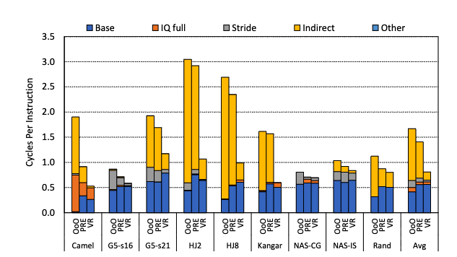
Motivation
Memory wall: modern workloads feature sparse, indirect memory accesses that are hard to predict
Indirect load instructions account for the majority of memory-access cycles
Cache-system level prefetchers are not good enough

Slide 3
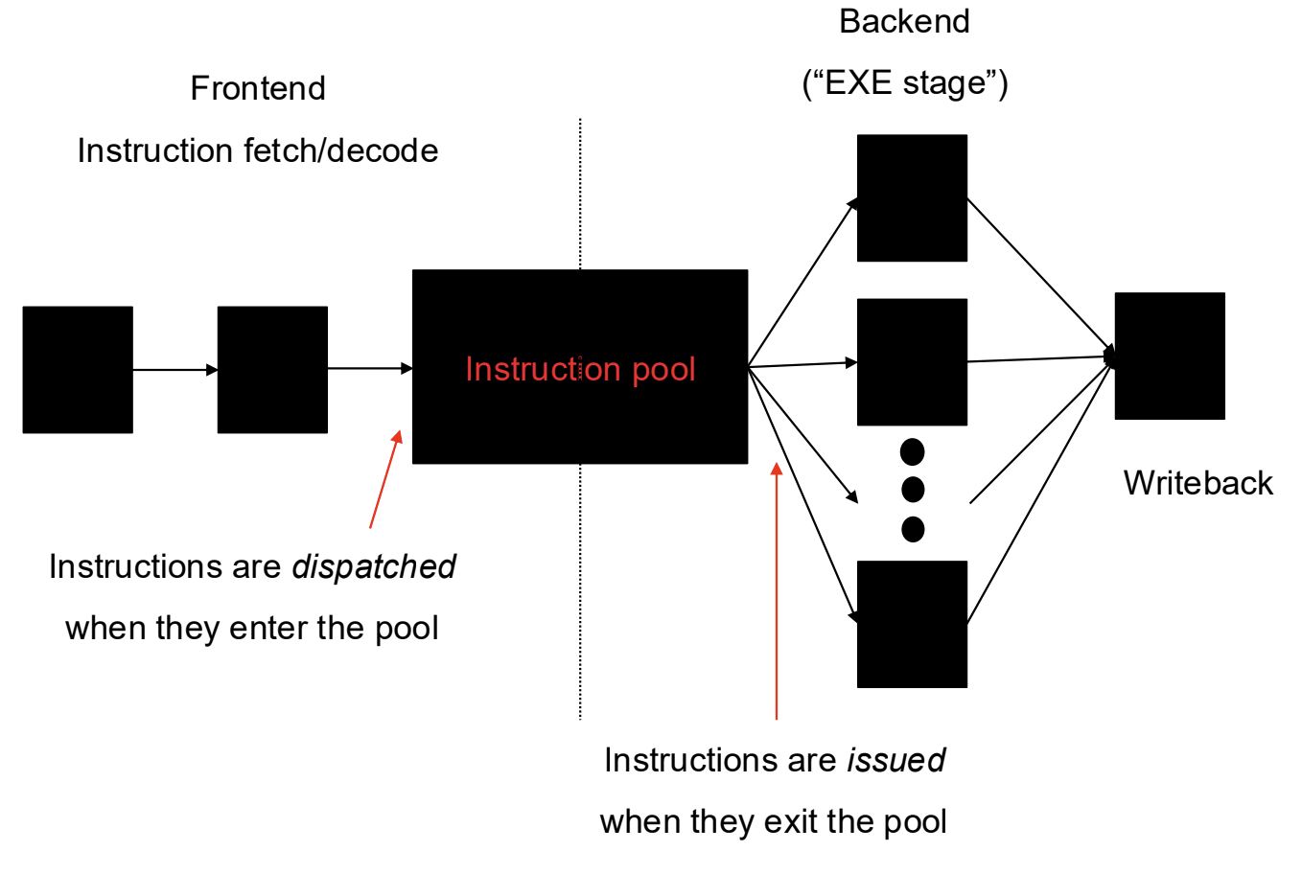
Background: Full-Window Stalls
Re-order buffer (ROB)
  The purpose of the re-order buffer (ROB) is to ensure we modify architectural state in program order in out-of-order processors
  The ROB is a circular buffer that is enq in decode and deq in writeback in order
  Think of the ROB analogous to an ‘instruction pool’ that must be dequeued in program order
Last-level cache miss → ~100 cycles to access DRAM
  When the load reaches the head of the ROB and the frontend fills up the ROB, we get a full-window stall
Enq ROB
Deq ROB

Slide 4
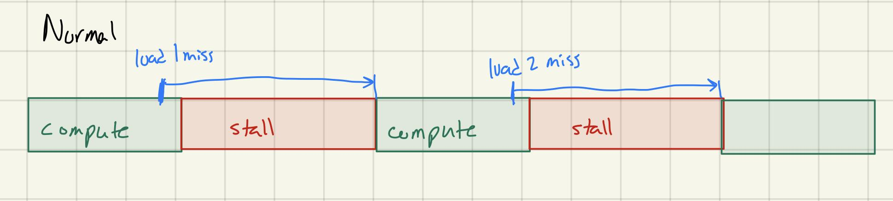
Background: Runahead Execution
Initiate prefetch from the core instead of within the cache
How to achieve the memory-level parallelism of a large instruction window with a small window?
Notes:
Assuming 2 independent loads
With a bigger instruction window we could overlap these 2 loads
https://www.youtube.com/watch?v=z8YpjqXQJIA

Slide 5
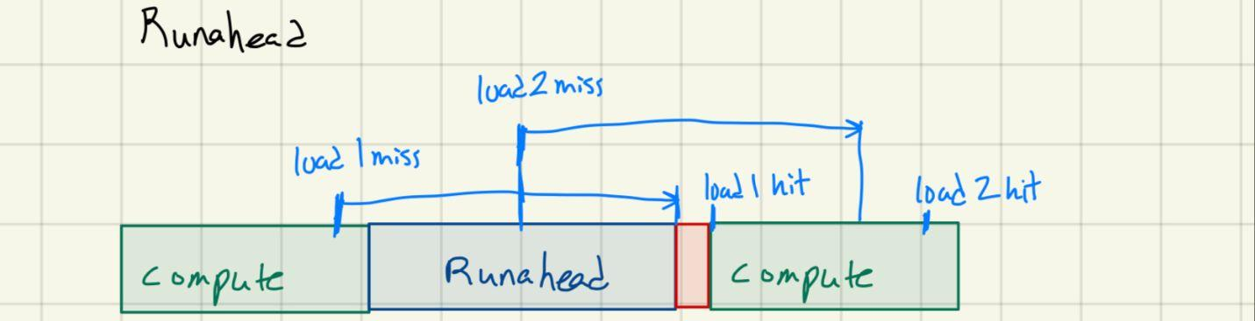
Background: Runahead Execution
When a full-window stall occurs:
  Checkpoint architectural state
  Enter runahead mode
Runahead mode
  Speculatively pre-execute instructions
    Instructions are pseudo-retired and do not modify architectural state
    Instructions are issued only to prefetch data into cache
Runahead mode ends when the original miss returns
  Flush the pipeline
  Restore architectural state
  Resume normal execution
Notes:
Checkpoint pc, arf, branch history reg and ras
Pseudo-retires instructions
https://www.youtube.com/watch?v=z8YpjqXQJIA

Slide 6
Background: Runahead Execution
When a full-window stall occurs:
  Checkpoint architectural state
  Enter runahead mode
Runahead mode
  Speculatively pre-execute instructions
    Instructions are pseudo-retired and do not modify architectural state
    Instructions are issued only to prefetch data into cache
Runahead mode ends when the original miss returns
  Flush the pipeline Re-filling the frontend & ROB with 100s of entries is expensive
  Restore architectural state
  Resume normal execution
Notes:
Checkpoint pc, arf, branch history reg and ras
Pseudo-retires instructions
https://www.youtube.com/watch?v=z8YpjqXQJIA

Slide 7
Background: Precise Runahead Execution
Key observation: Runahead does not modify architectural state.
We don’t need to use the ROB.
When a full-window stall occurs:
  Checkpoint architectural state
  Enter runahead mode
Runahead mode
  Speculatively pre-execute instructions Only execute long-latency load instructions (stored in a stalling slice table)
  Use available issue queue and physical register file resources
Runahead mode ends when the original miss returns
  Flush the pipeline Don’t need to flush ROB
  Restore architectural state
  Resume normal execution
Notes:
PC, RAT, RAS
https://www.youtube.com/watch?v=z8YpjqXQJIA
the processor has sufficient unused resources in the
issue queue and physical register file to continue speculatively
executing instructions in runahead mode, eliminating the need
to release processor state in the reorder buffer (ROB), issue
queue (IQ), and physical register file (PRF)
We refer to the load instruction that causes
a full-window stall as a stalling load, and to the backward
chain of instructions that leads to a stalling load as a stalling
slice.

Slide 8
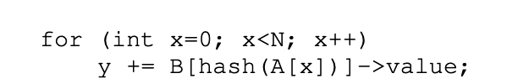
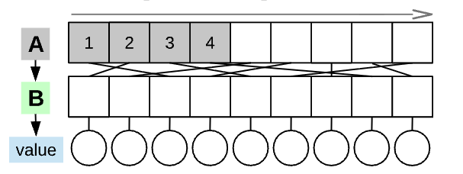
Background: Precise Runahead Execution
PRE does not prefetch indirect memory accesses
Assume A[0] triggers runahead:

Slide 9
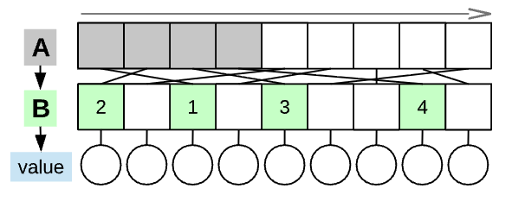
Background: Precise Runahead Execution
Modern processors have a stride prefetcher
Assume A[0] hits in cache, B[hash(A[0])] triggers runahead

Slide 10
Background: Precise Runahead Execution
Limitations:
Cannot prefetch memory access patterns with arbitrary degree of indirection
Rate that PRE can issue speculative prefetches is limited by the frontend bandwidth

Slide 11
Vector Runahead Main Contributions
Vectorize scalar instructions to perform more prefetch instructions
  Increase backend throughput without putting extra pressure on the frontend
Unroll and pipeline vector instructions to perform even more prefetch instructions
Stay in runahead mode until all dependent loads have been issued

Slide 12
Vector Runahead
When a full-window stall occurs:
  Checkpoint architectural state
  Enter runahead mode
Runahead mode
  Speculatively pre-execute instructions Only execute long-latency load instructions (stored in a stalling slice table)
  Vectorize scalar instructions and apply pipelining/unrolling
  Use available issue queue and physical register file resources
Runahead mode ends when the original miss returns Leave runahead after all dependent loads have been issued
  Flush the pipeline Don’t need to flush ROB
  Restore architectural state
  Resume normal execution
Notes:
PC, RAT, RAS
https://www.youtube.com/watch?v=z8YpjqXQJIA
the processor has sufficient unused resources in the
issue queue and physical register file to continue speculatively
executing instructions in runahead mode, eliminating the need
to release processor state in the reorder buffer (ROB), issue
queue (IQ), and physical register file (PRF)

Slide 13
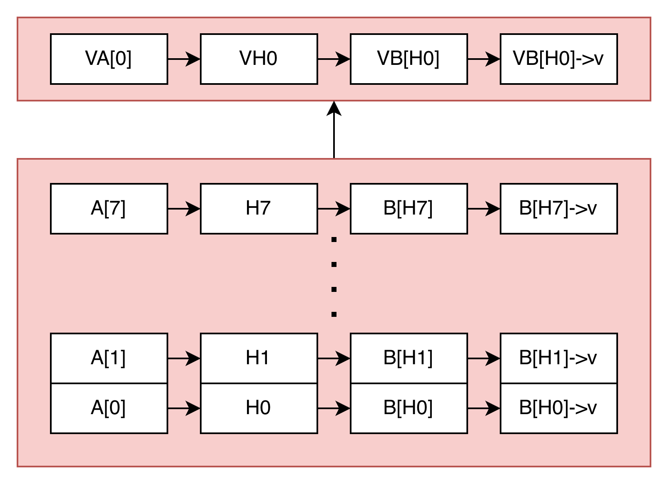
Vectorizing scalar instructions
Loop iterations
Notes:
https://ajnaithani.github.io/docs/isca21_slides.pdf#page=1.00
Black arrows are data flow / show data dependencies
This is a lot of instructions

Slide 14
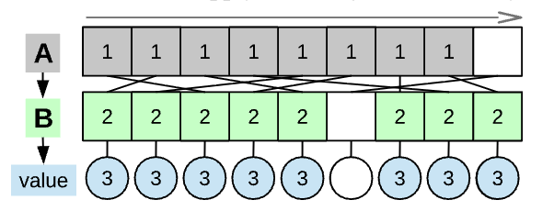
Vectorizing scalar instructions
Notes:
https://ajnaithani.github.io/docs/isca21_slides.pdf#page=1.00
Instead, when we decode A[0], we can translate A[0] to the vectorized load

Slide 15
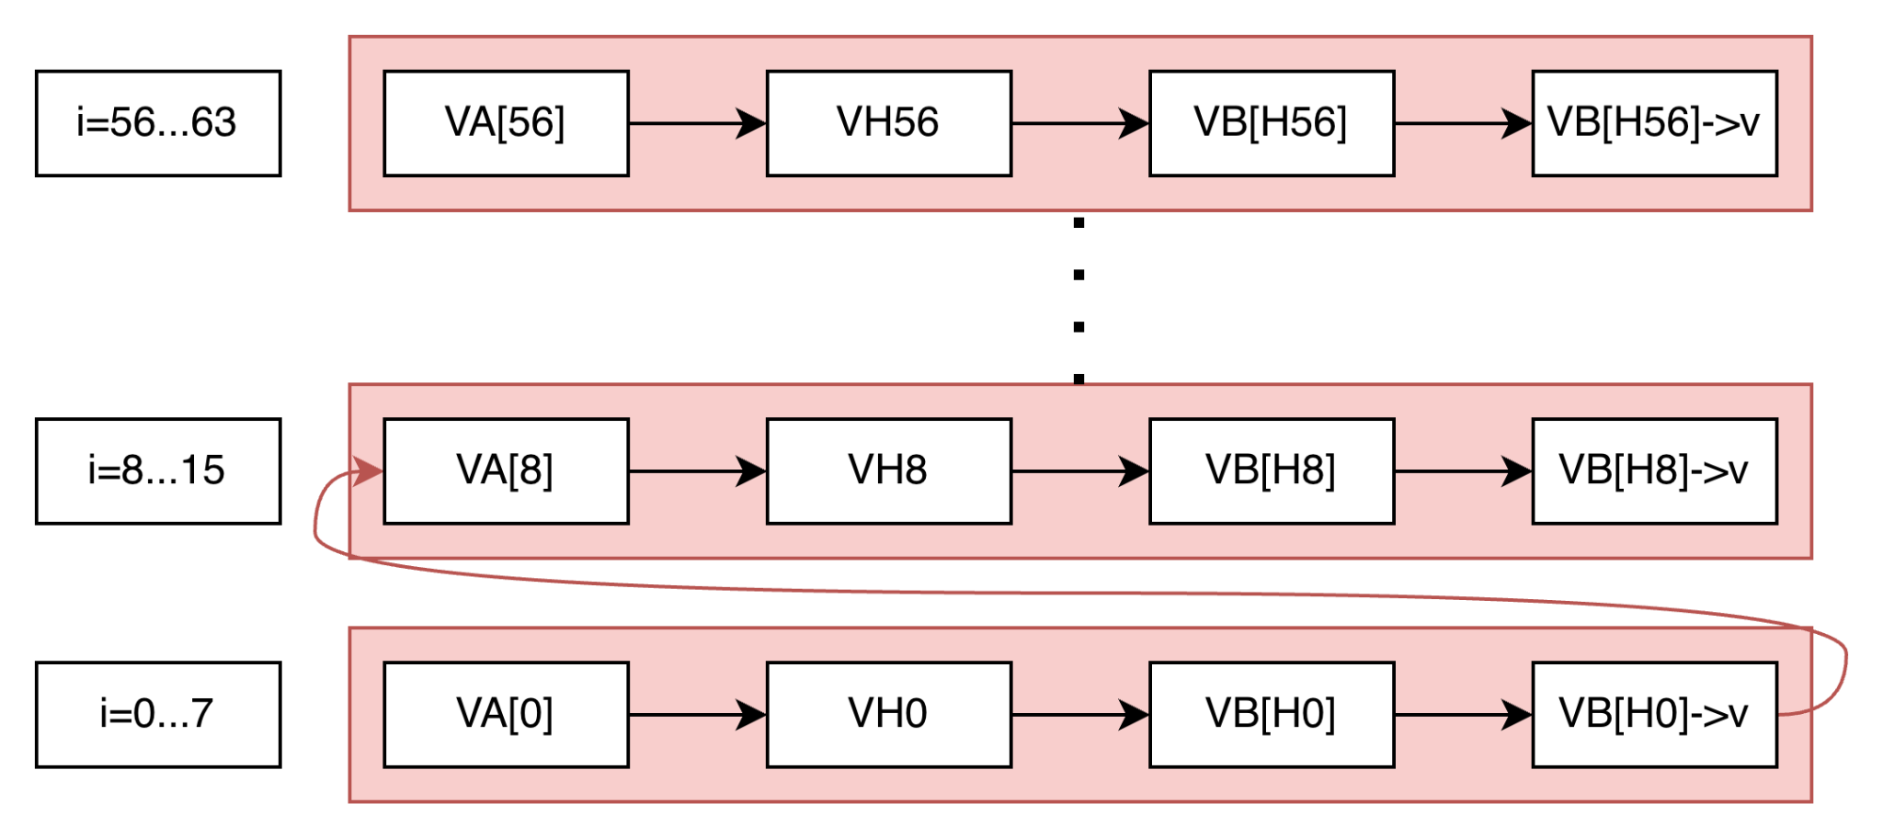
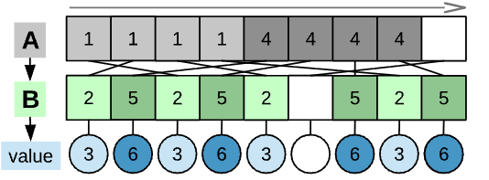
Unroll Vector Instructions
Notes:
https://ajnaithani.github.io/docs/isca21_slides.pdf#page=1.00
Red arrow is order of execution
Each vertical column has no data dependencies, can issue in parallel to overlap stalls

Slide 16
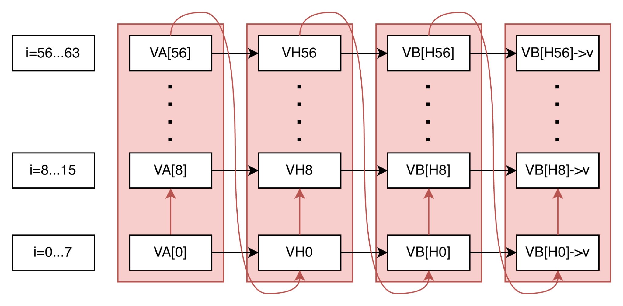
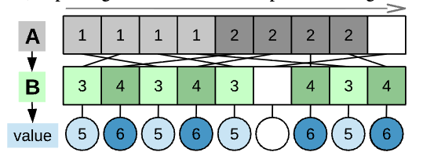
Pipeline Vector Instructions
Notes:
https://ajnaithani.github.io/docs/isca21_slides.pdf#page=1.00
P copies of a scalar register: we over P operations

Slide 17
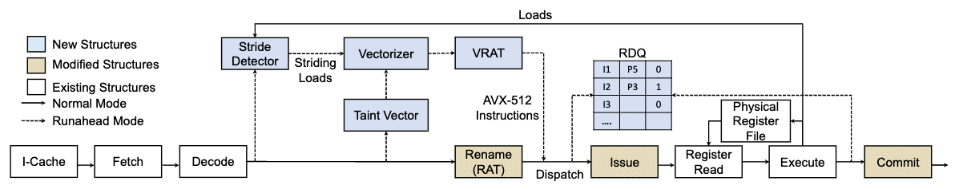
Microarchitecture overview
1.31 KB SRAM overhead (compared to 1.24KB overhead with PRE)

Slide 18
Stride Detector
Used to determine ‘induction variables’ or stride for vectorized memory accesses
Stores ‘terminator’ PC which tells us when to terminate early
Is this instruction a strided load?
  Yes: enter vector runahead mode
  No: do precise runahead

Slide 19
Taint Vector
Tells us what operations depend on the vectorized loads
Vectorize bit: was the previous instruction to write to this register a vector instruction?
  0: Scalar / 1: Vectorize
Invalid bit
  0: Discard / 1: Don’t discard

Slide 20
Vectorizing Instruction
Vectorizer generates vectorized instructions via a microprogrammed routine
Scalar architectural registers and renamed to vector physical registers using the vector Register Allocation Table (VRAT)
  1 architectural register → P vector physical registers
Deallocate registers using the Register Deallocation Queue (RDQ) (similar to PRE)
  Like a surrogate ROB
Notes:
four conditions is satisfied: (1) we encounter a dynamic
instance of the same striding load again; (2) we encounter, and
issue, the terminator: the PC identified by the stride detector
(Section III-B) as the last dependent load in the sequence;
(3) all vector lanes have been marked as invalid; or (4) we
time out (after 200 scalar-equivalent instructions have been
executed in vector-runahead mode), in case of traveling down
an unexpected code path.

Slide 21
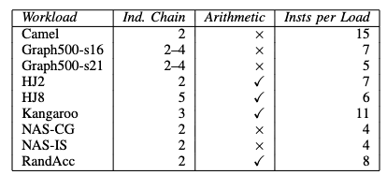
Experimental Setup
Sniper: a cycle-level model for superscalar OoO processors
Memory latency bound benchmarks based on HPC, graph, and database workloads

Slide 22
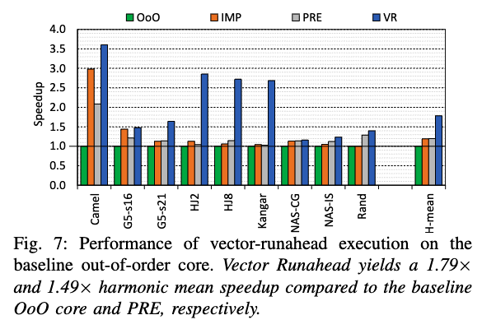
Performance

Slide 23
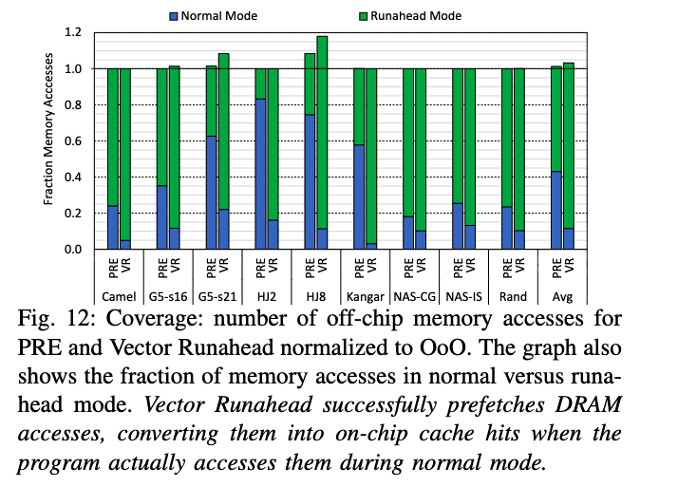
Coverage
Neither PRE / VR overfetches
VR has higher coverage

Slide 24
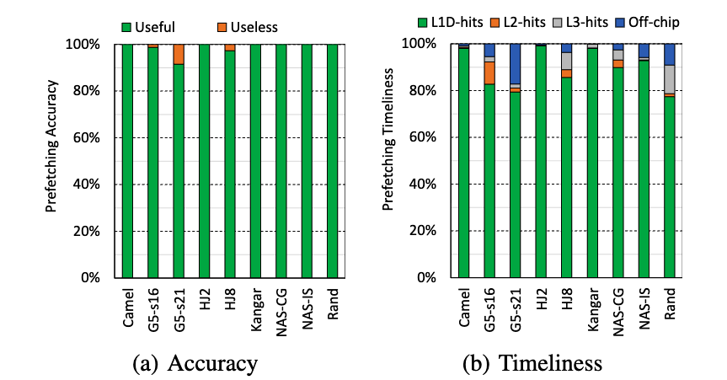
Accuracy and Timeliness
GS-s21: Large dataset w/ complex control flow
Notes:
(a) Accuracy: fraction of total prefetched cachelines
in runahead mode that are later accessed in normal mode.
(b) Timeliness: fraction of total prefetched cachelines in
runahead mode for which the data is present in the L1-D,
L2 and L3 caches during normal mode; ‘Off-chip’ represents
the cachelines for which the data is still being transferred
from memory.

Slide 25
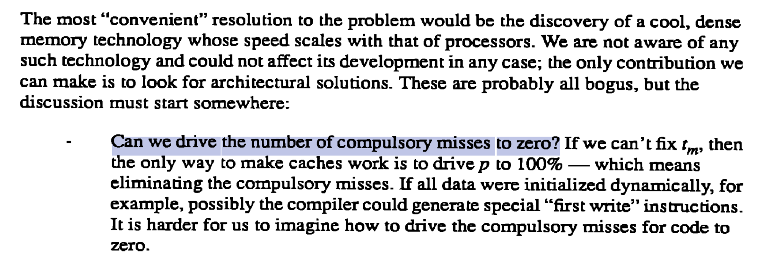
Discussion
The memory wall:

Slide 26
Discussion
Do you think that vector runahead could be implemented in modern processors? What are the relevant obstacles (security, microarchitecture feasibility, ...)?
This struck me as an elegant software-transparent auto vectorizer. I wonder what codes would be better served through traditional SW vectorization vs. hardware vectorization?
Hypothetically microarchitecture papers could propose arbitrarily complex designs that are not actually feasible in silicon. Should we expect papers like vector runahead to evaluate silicon design?

Slide 27
Thank you

Slide 28
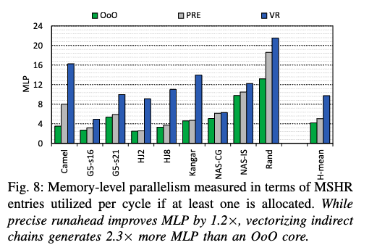
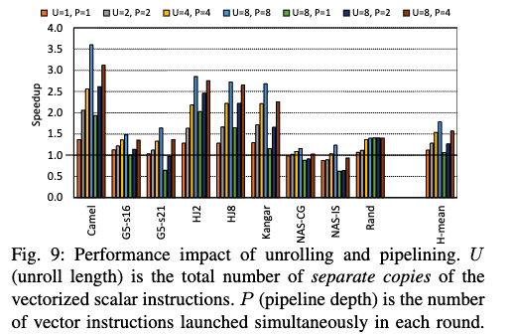
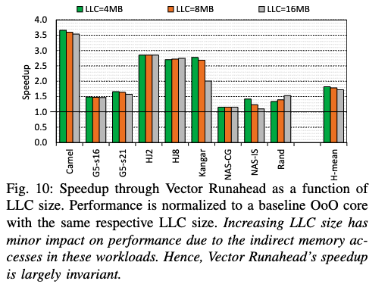
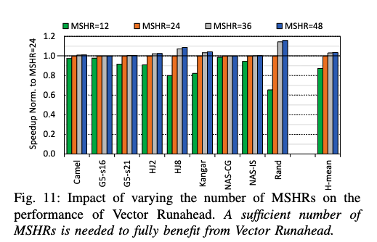
Sensitivity Analysis

Slide 29
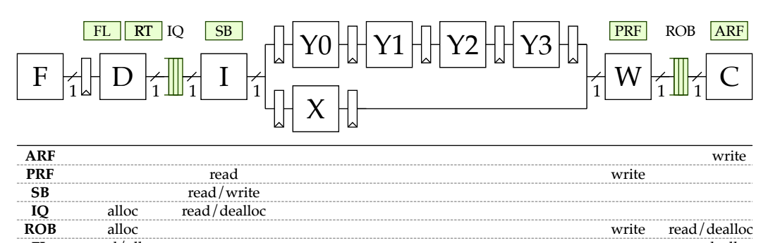
Background: Full-Window Stalls
Last-level cache miss → ~100 cycles to access DRAM
  When the load reaches the head of the re-order buffer (ROB) and the frontend fills up the ROB, we get a full-window stall
Source: Christopher Batten, ECE 4750, Cornell University (© 2022)

